Slide 1
Mocks and Stubs
Sharing by Andy Li

Slide 2
Test Case
Setup、Exercise、Verify、Tear down
System Under Test(SUT) dependency tree
Collaborator
Test Double

Slide 3
Test Double
Dummy: a object is passed around but never used
Fake: a object that have working implementations, but are usually simplified, such as an memory database
Stub: a class is an partial implementation for an interface or a class with the purpose of using an instance to record information about method calls, record information that called state be used to verify test exception
Mock: an implementation of an interface or a class in which you can define the return value of certain method calls, based on behavior verification during a test

Slide 4
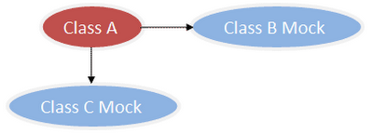
Test Double

Slide 5
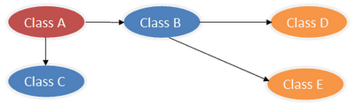
Dependency Tree

Slide 6
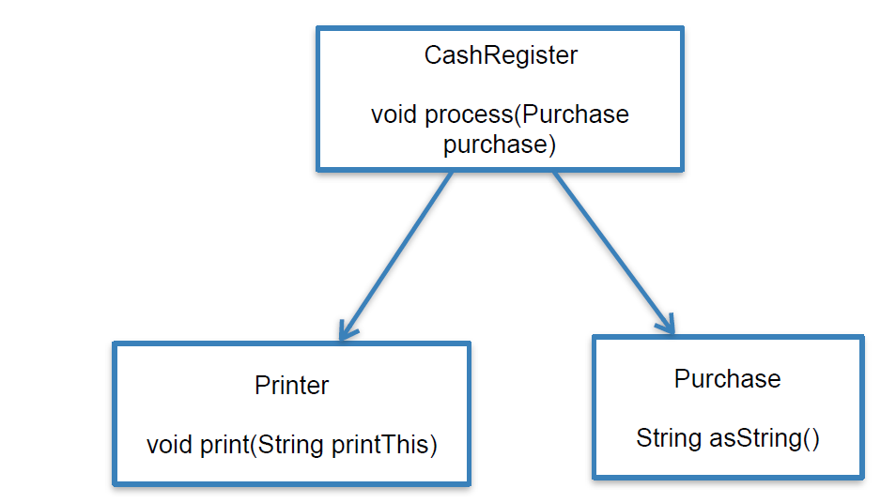
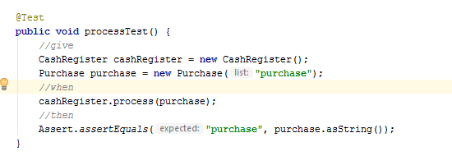
Example

Slide 7
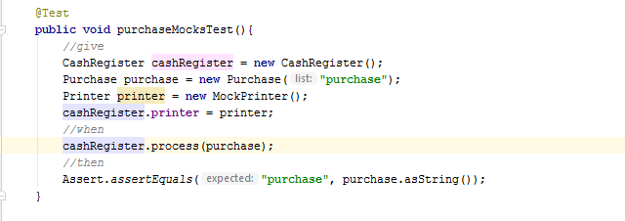
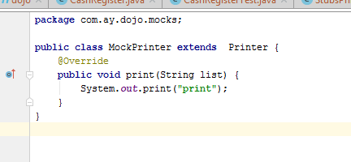
Mocks
In order to preserve the “unit” in unit test
Test manner based on behavior verification, using mocks

Slide 8
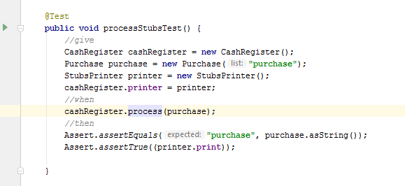
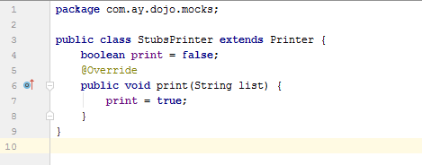
Stubs
Test manner based on state verification, using real dependency or test double

Slide 9
Difference
Test Double may be used to Mocks or Stubs，difference between Mocks and Stubs is what approach will be used for verifying the test result。
Mocks use Test Double to mimic real object
Stubs use real Dependency object or Test Double to mark state of test result。
Using Mocks or Stubs is depend on your test case。

Slide 10
Mockito
Creating mock objects with Mockito
Configure mocks
Wrapping objects with Spy
Verify the calls on the mock objects

